Slide 1

A strategy for solving problems
Module 6.1

Slide 2
Content
Introduction
General problem solving
The role of questions
Activity 1
Data and information
Activity 2
Test and improve

Slide 3

Introduction
Most problems are solved ‘automatically’. You don’t even realise that you are actually following some steps.
Suppose you want to go out with friends and need to decide what to wear.
What will the weather be like?
It will be chilly
What do I have in my cupboard?
I have 3 nice shirts; there is a warm jacket in my closet
Where are we going?
We’re going to the movies
Make a decision
Wear a shirt and the warm jacket

Slide 4


Introduction (continued)
Suppose you get a mark of 50 for a test. You want to know whether the mark is good or bad.
How much is the test out of?
The test is out of 60.
Process this: 50 ÷ 60 x 100 = 83.3%
Make a decision
83% is a very good mark! ☺

Slide 5
General problem solving
The following basic steps can be followed to solve problems:
Analyse the problem
Collect data and information and process it
Solve the problem and present the solution / information

Slide 6
The role of questions
?
?
?
?
?
}
What needs to be done or solved?
What aspects of the problem should I take into account?
What is given? What is known?
What is missing? What information do I still need?
Helps you to understand the problem, and what facts and information you still need
Closed questions: What? When? Who? How many? Where?
Open-ended questions: How? What if?

Slide 7

Activity 1

Slide 8
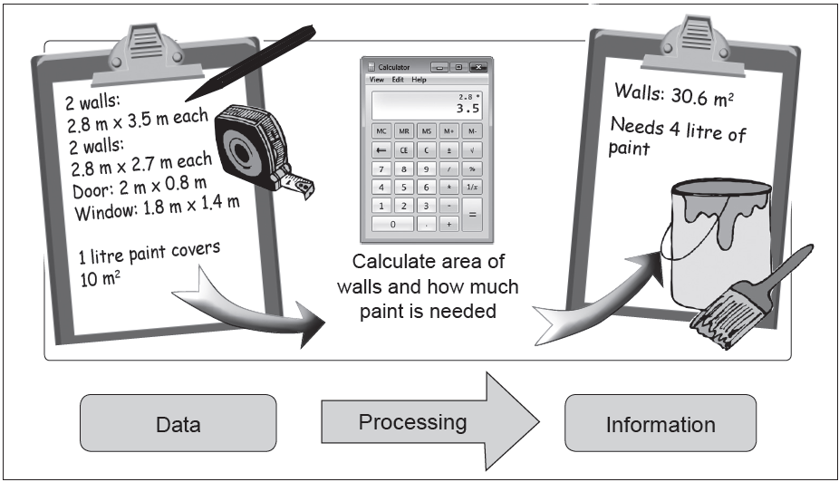
Data and information
The difference between data and information
Data: raw facts or items.
Information: processed facts or data.

Slide 9
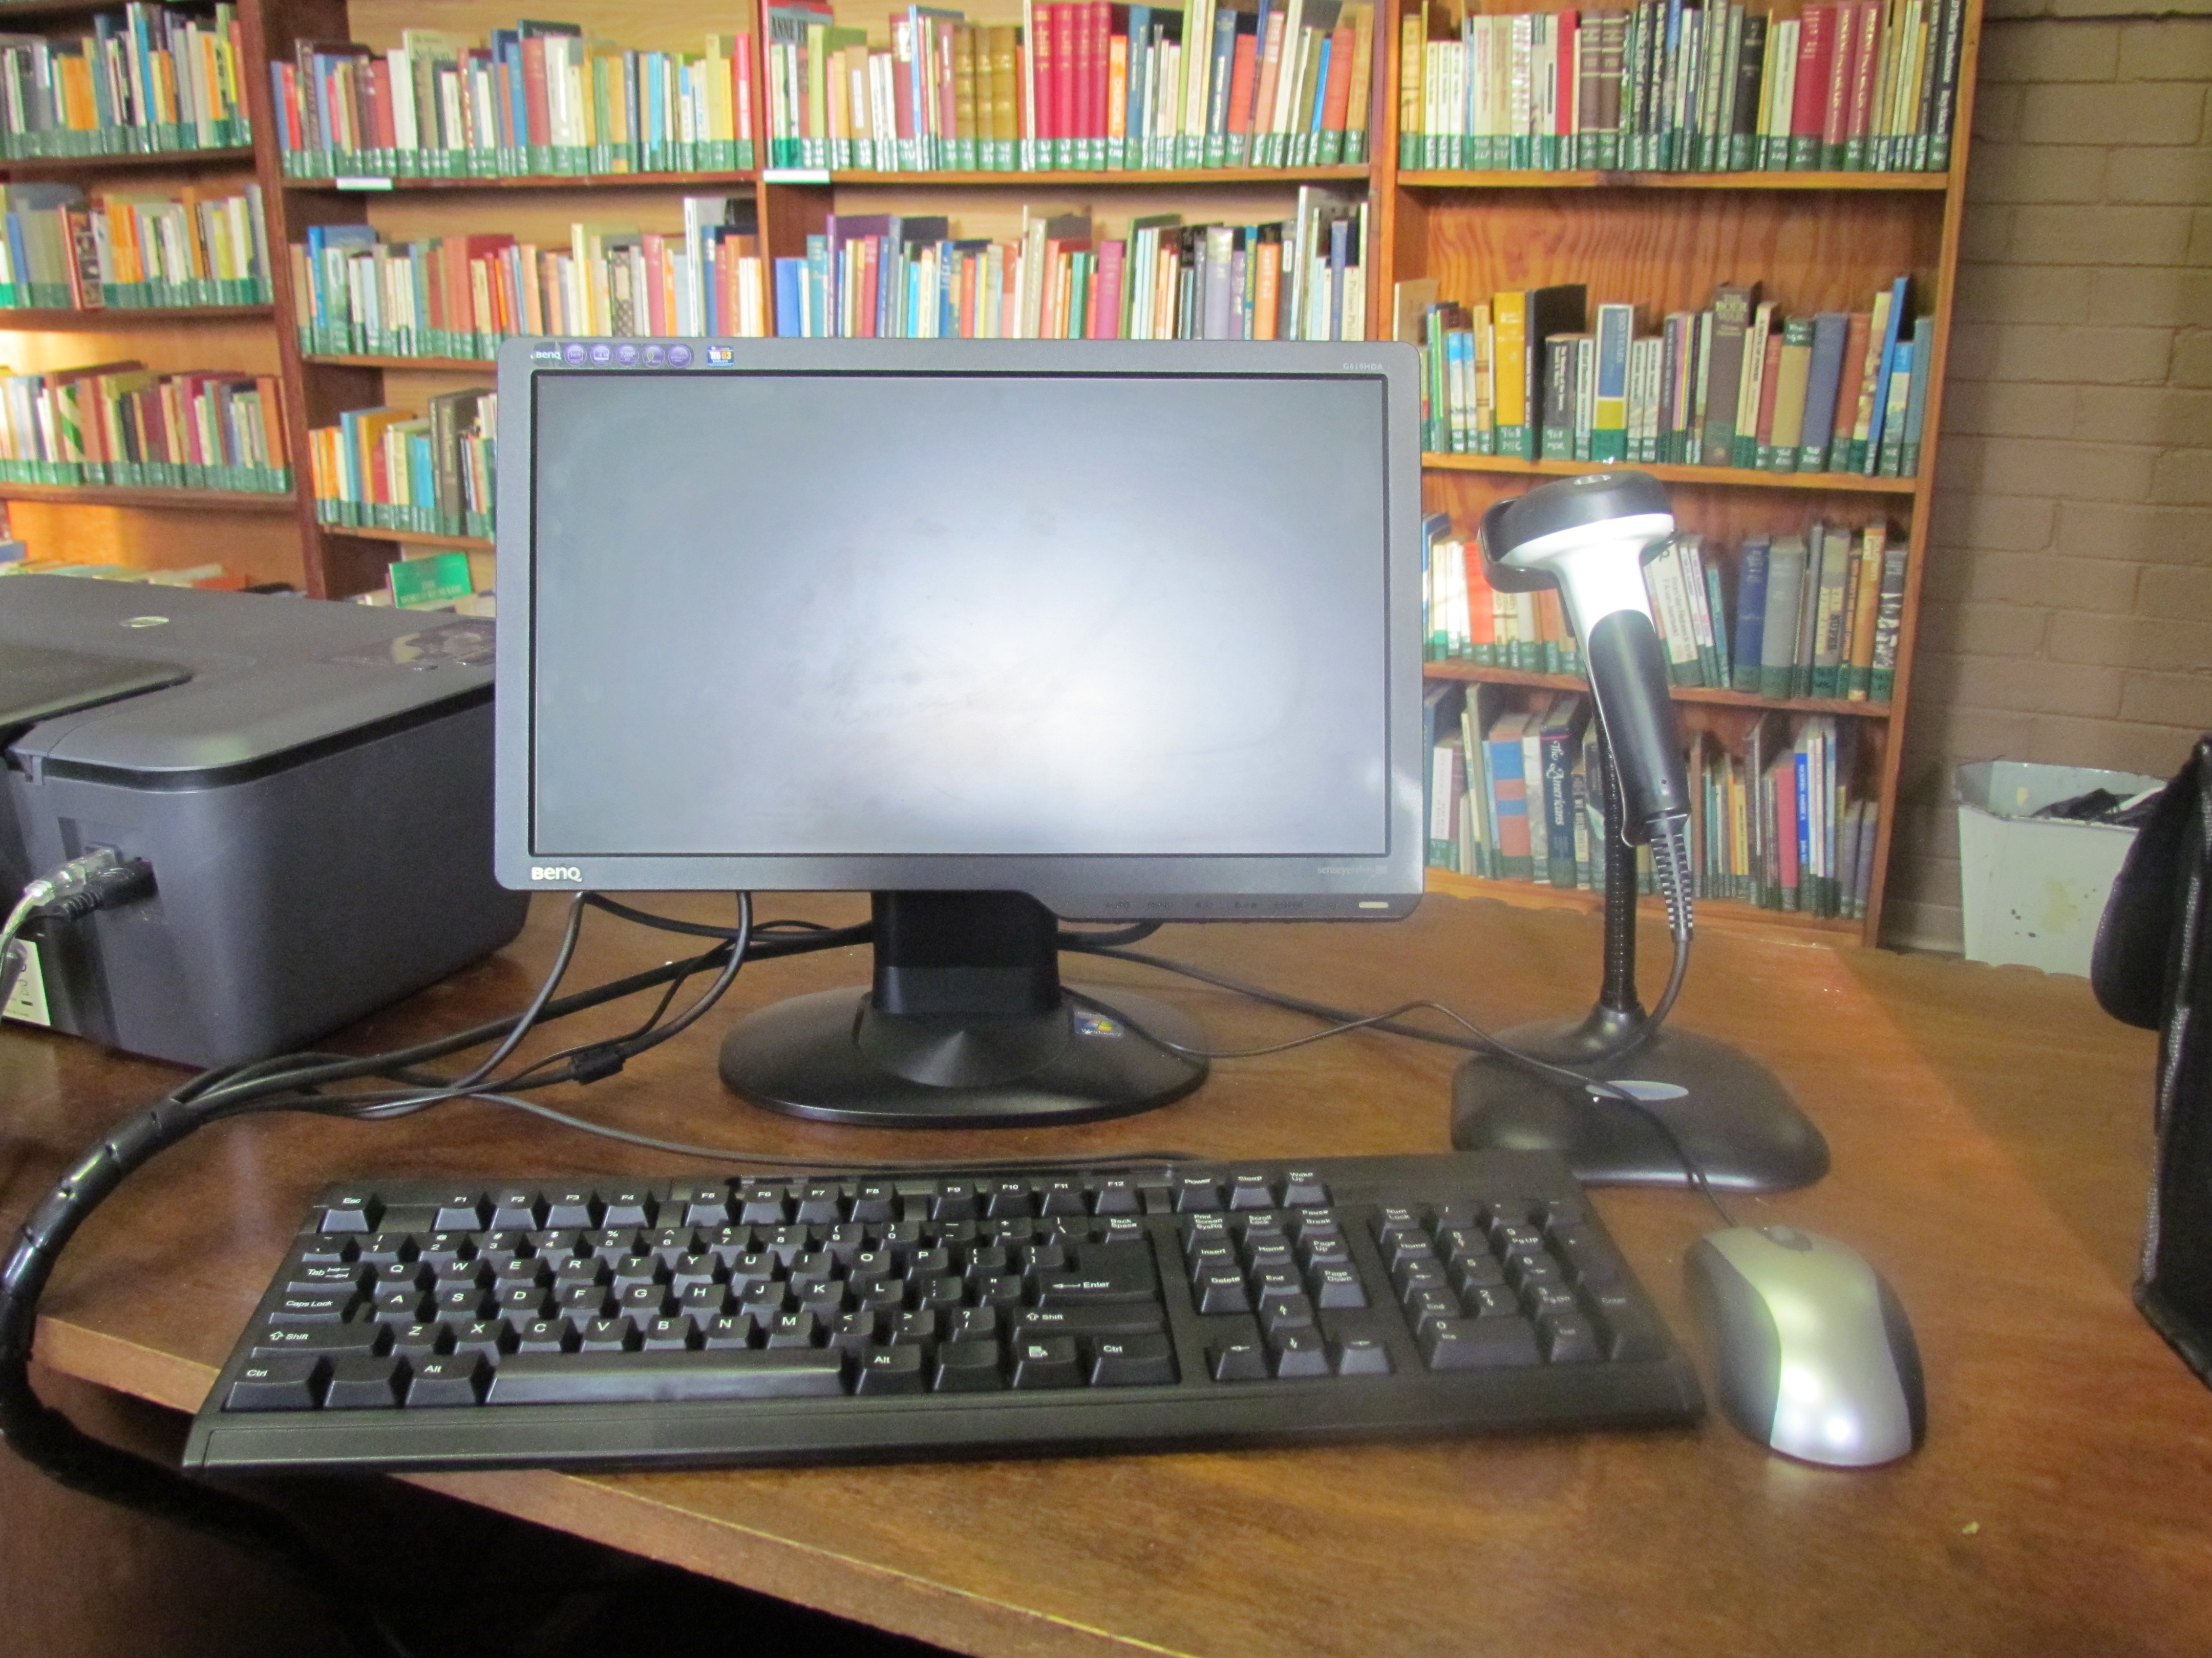
Data and information (continued)
INFORMATION SOURCES
Electronic media A way of using an electronic device to get digital content to a user
Web preferred source of information
computers
smartphones
radio
TV

Slide 10
Data and information (continued)
INFORMATION SOURCES
Printed media
A lot of material has never been published digitally and is available only in hardcopy
Books often contain more in-depth information than can be found online
Printed media can be easier to work with, in terms of paging and making physical notes
books
magazines
journals

Slide 11
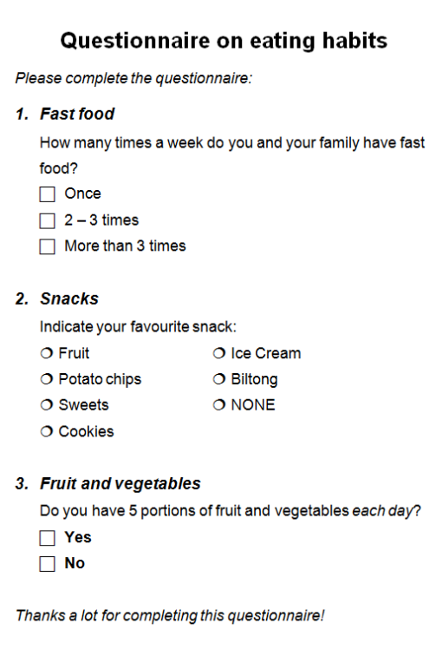
Data and information (continued)
INFORMATION SOURCES
People
Questionnaires
Information about people’s ideas, opinions, habits, likes and dislikes
Let respondent select an answer (closed question)
These values are the data, after processing it becomes information

Slide 12
Data and information (continued)
INFORMATION SOURCES
People
Interviews
Plan your questions and write them down
Make an appointment with the person
Be polite and be friendly
Confirm whether you may make notes or record the interview
Do not take too long and stick to the topic

Slide 13
Data and information (continued)
INFORMATION SOURCES
People
Interviews – make notes of the content
the date
the person interviewed
the rank or position of the person, i.e. the reason why you interviewed the person
(You are going to use this in your references)

Slide 14
Activity 2

Slide 15
Test and improve
Problem
What is a problem?
What is problem solving?
Role of questions
Why do we ask questions?
Types of questions
Sources of information
Electronic media
Printed media
People
Other
How do you analyze a problem?
Data vs. Information
What is data or facts?
What is information?

